Slide 1
SawyerAir
Exploring traveling possibilities

Slide 2
A project made by
Andronie Bertha
Avram Vlad
Stinga Adelin

Slide 3
Functionalities:
Register
Login
Explore Available Routes
Explore Flights for the selected Routes
See the Stops
Pay and book the desired Flight
Manage account

Slide 4
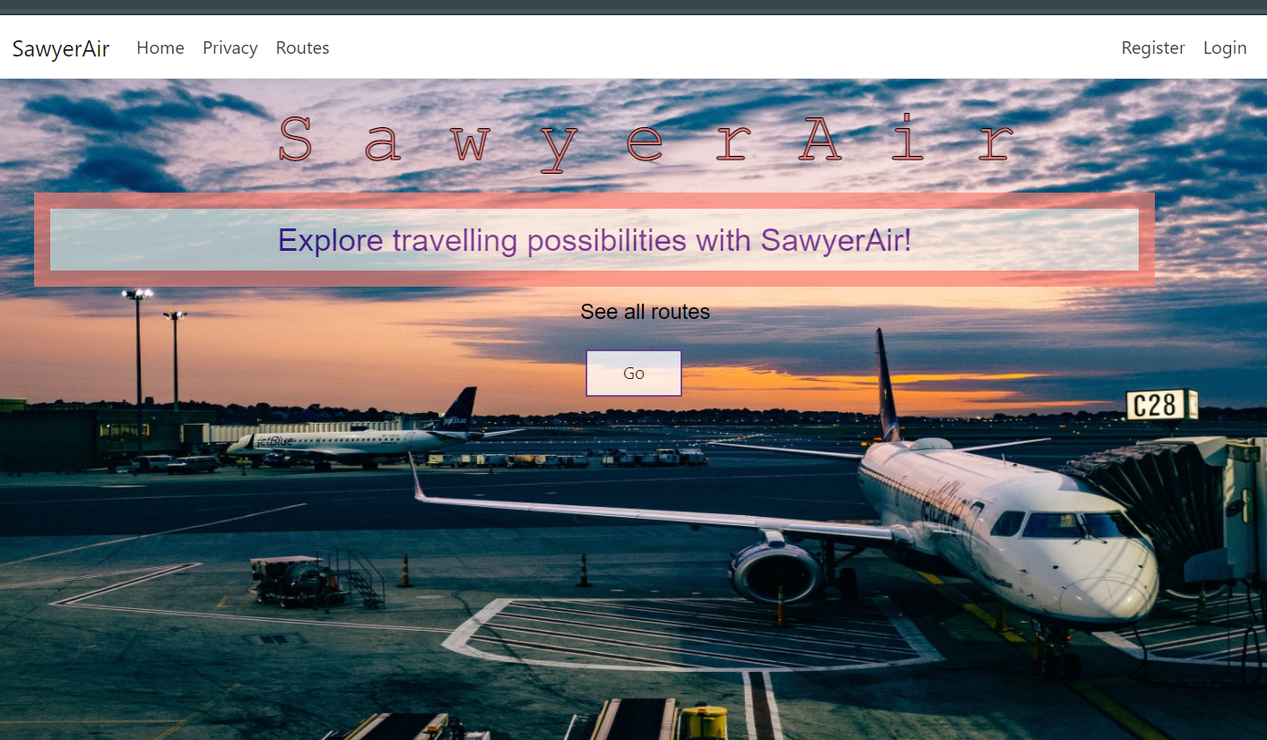
Register
The user can create a new account by pressing the “Register” button in the top right part of the app

Slide 5
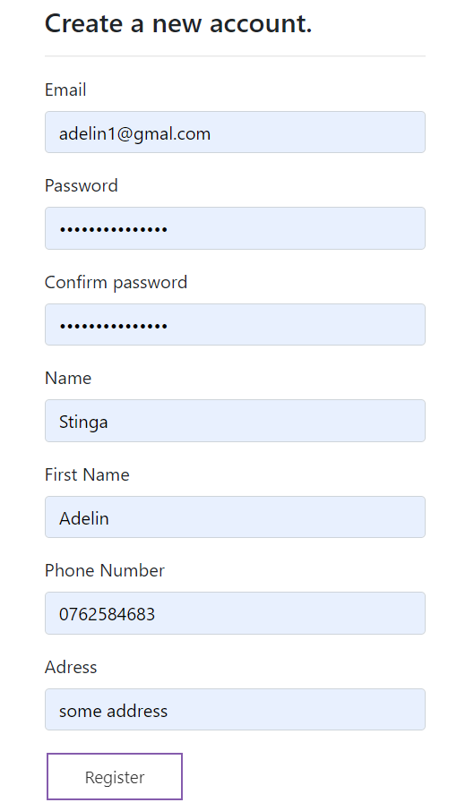
Action
By pressing the “Register” button the user is sent to a new page where he/she can enter the information needed to create a new account (all fields must be filled)

Slide 6
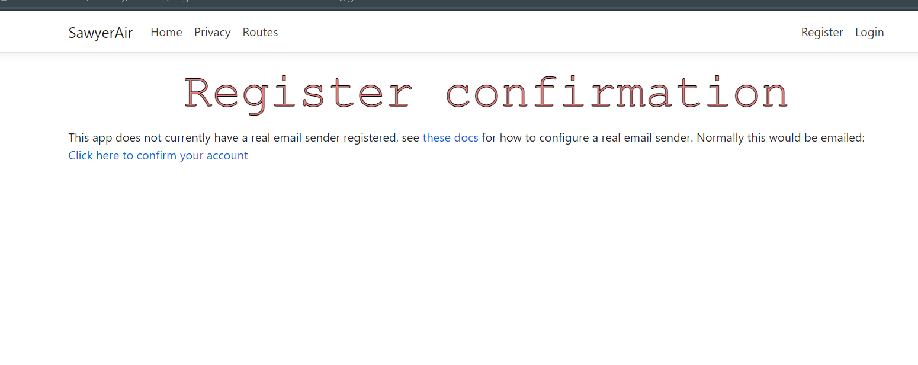
Result
By pressing the “Register” button in the bottom, the user will be sent to a page where it has to “confirm the email” but by pressing the “Click here to confirm account” the account is created

Slide 7
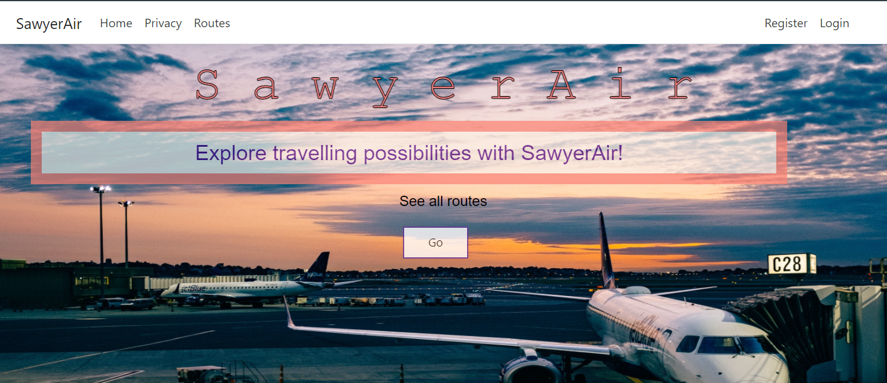
Login
The user can log in into an existing account by pressing the button “Login” from the top right corner of the app

Slide 8
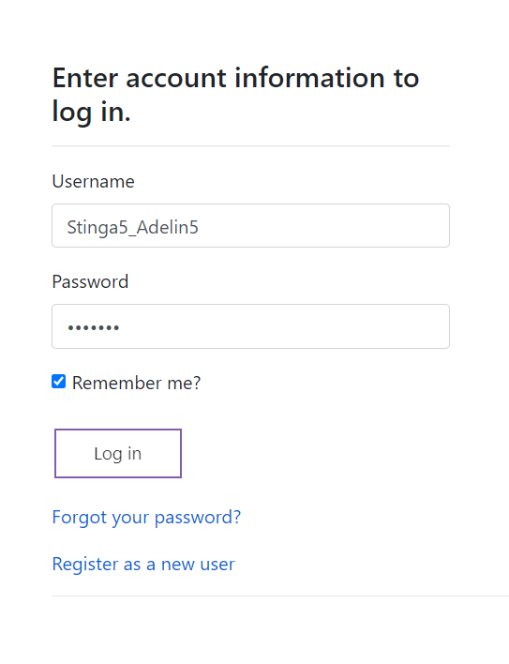
Action
By pressing the “Login” button the user is sent to a new page where he/she can enter the information needed to make this action possible
The Username is created by combining the name with the surname of the user (ex. Name_Surname)

Slide 9
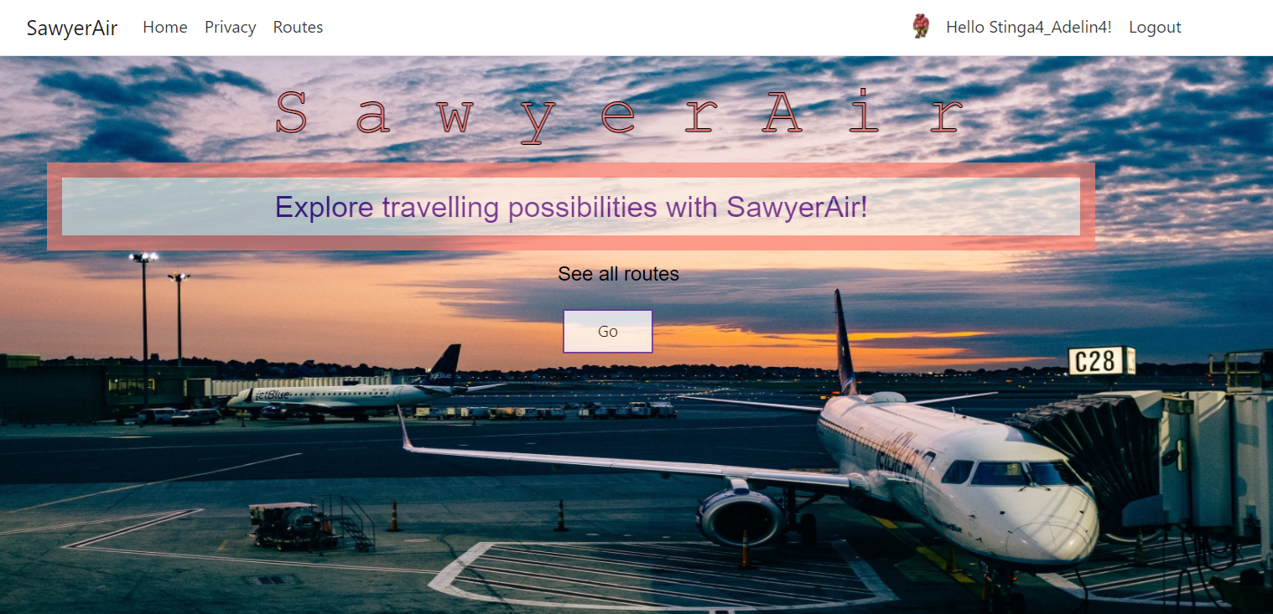
Result
By pressing the “Login” button in the bottom, if the credentials are correct, the user will be sent to the home page where he/she can start other actions such as browsing trough the available flights and booking the desired ones by pressing the button “Go” from the Home page

Slide 10
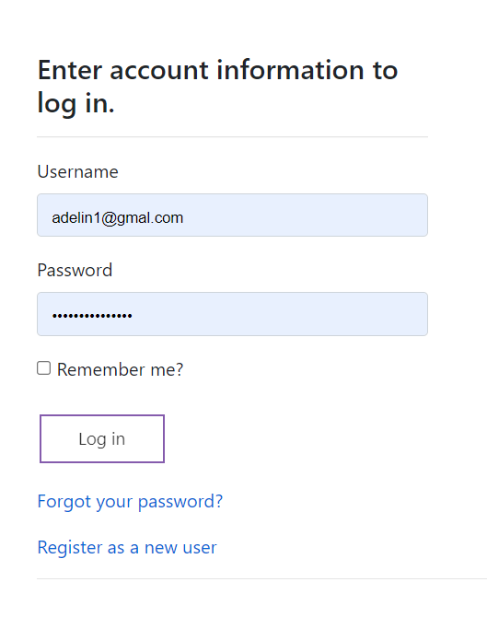
Other actions
If the user forgot the password for the account, by pressing the link “Forgot your password?”, the user is sent to a new page where the email is required to recover the account (Red highlight)
If the user doesn’t have an account and pressed by mistake the “Login” button, he/she can press the link “Register as a new user” to create a new account (Blue highlight)

Slide 11
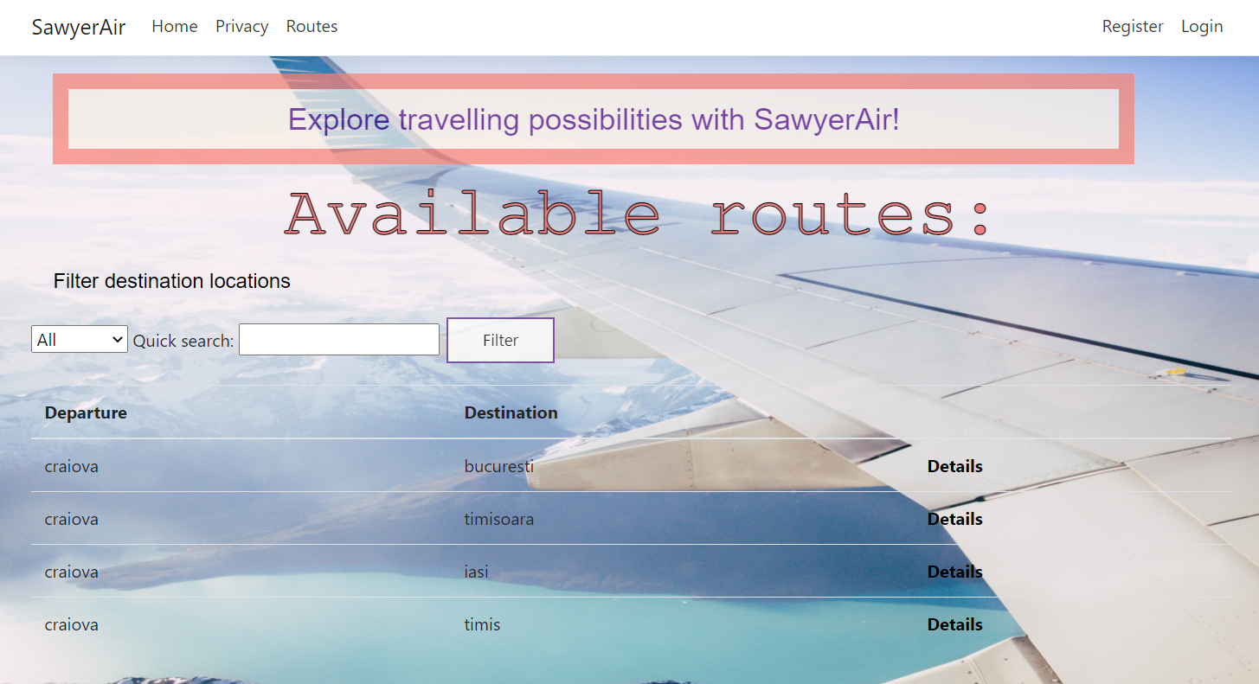
Explore Available Routes
By pressing the “Routes” button in the top left corner of the app, the user is sent to a page where he/she can browse trough the available routes and perform some other actions for a better experience

Slide 12
Actions
The user can browse trough a smaller field of routes by filtering the routes. This action is done by entering the departure location in the placeholder next to “Quick search” and pressing the “Filter” button (Red highlight)
If the user is interested in one of the routes, then by pressing the “Details” link then the user is sent to another page for further actions (Blue highlight)

Slide 13
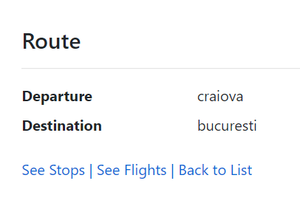
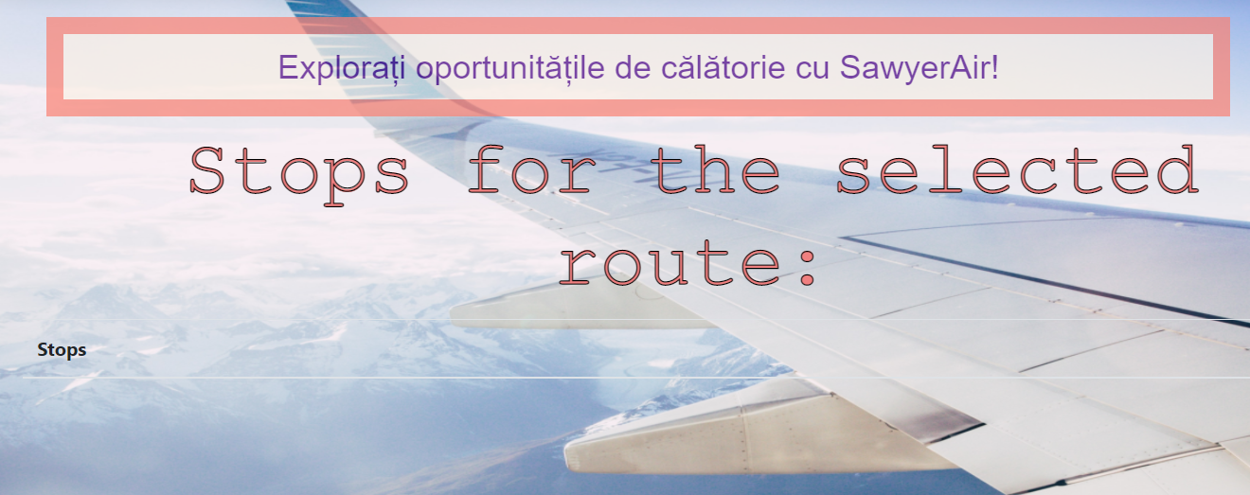
See Stops
After pressing the “Details” link the user can view summary details about the route and can see the stops that are done on that route by pressing the link “See Stops”

Slide 14
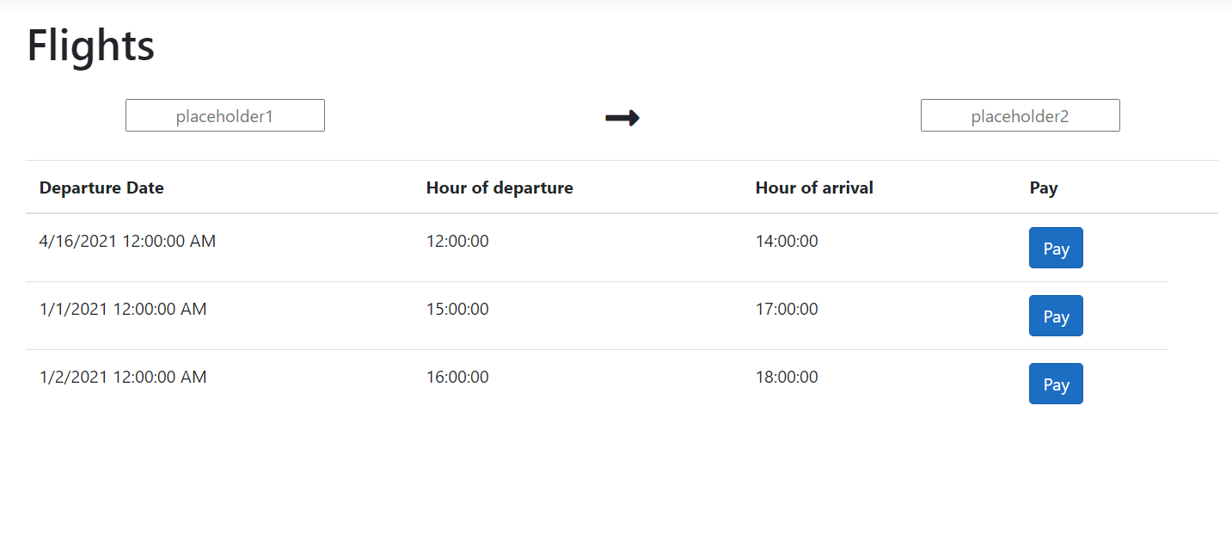
See Flights
By pressing the link “See Flights” the user is sent to a page where all the available flights for the route searched are presented (Blue highlight)
In the page “Flights” the user can choose what interval he whish the flight to be and by pressing the “Book” button he/she will be sent to a new page where the transaction will be done (Red highlight)

Slide 15
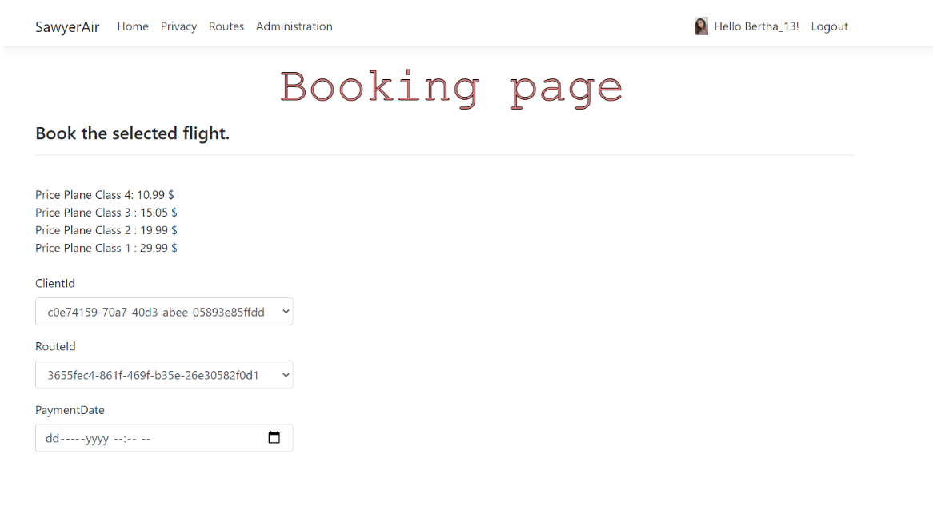
Booking page
When the user decides what flight he/she wants, by pressing the “Book” button, it is sent to the Booking page where he can see the prices for the flight and fill some necessary fields to complete the action

Slide 16
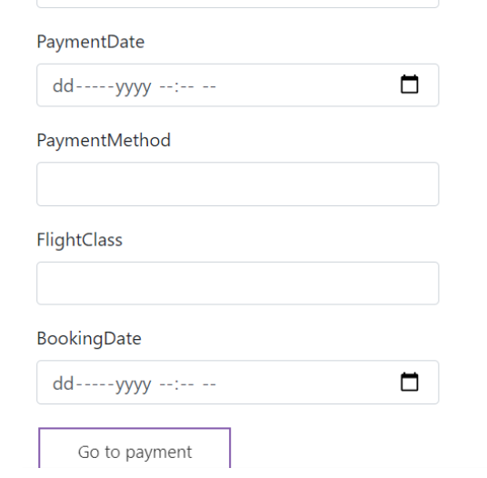
Action
The fields needed to be filled are presented to the right
After filling this fields, by pressing the “Go to payment” button, the user is sent to a page where he/she can input the card details to complete the booking action

Slide 17
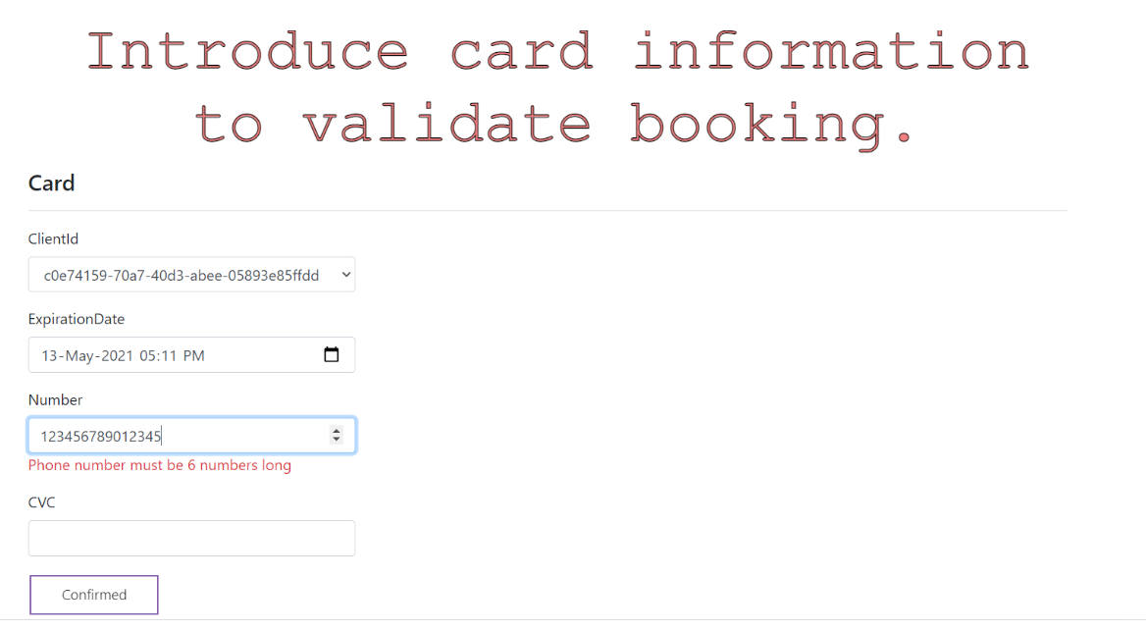
Card info action
On this page the user has to input the personal information of the card and by pressing the “Confirmed” button, the action is done.

Slide 18
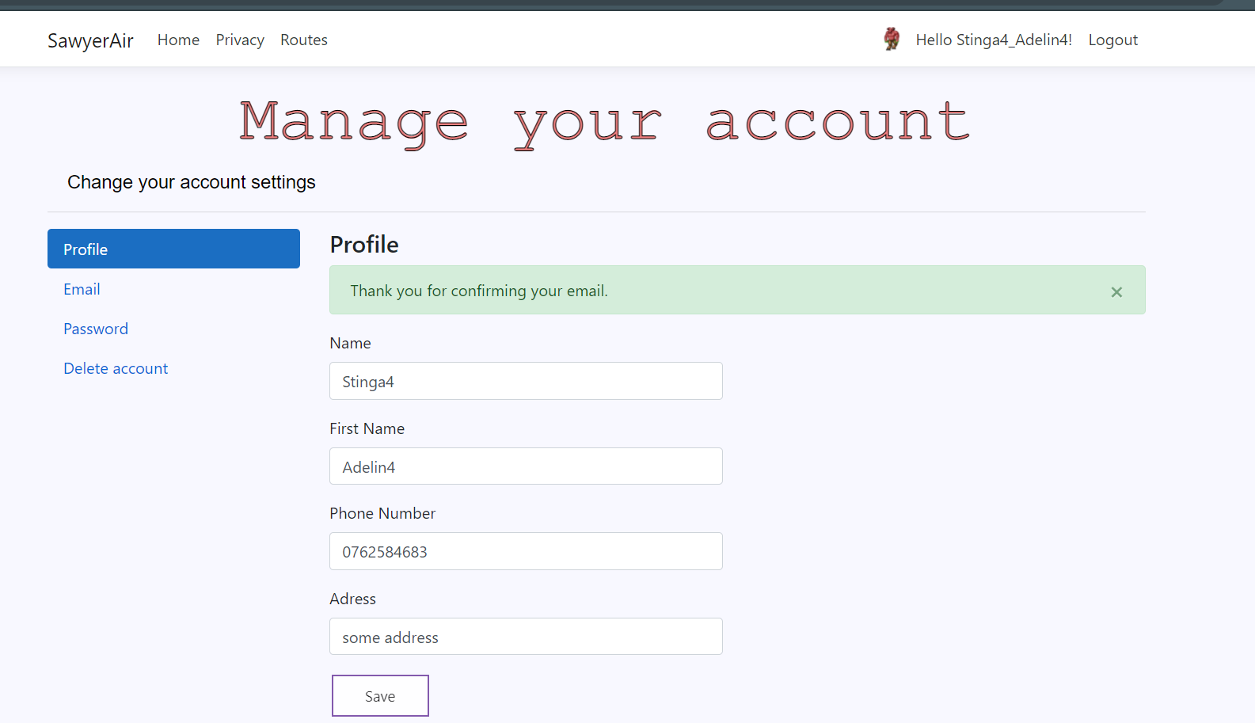
Manage account
While connected to the account the user has the option to manage the account information by pressing on the username in the top right corner of the app

Slide 19
Possible actions
There are 4 possible actions that can be done: manage the profile information, change the email, change the password, delete the account

Slide 20
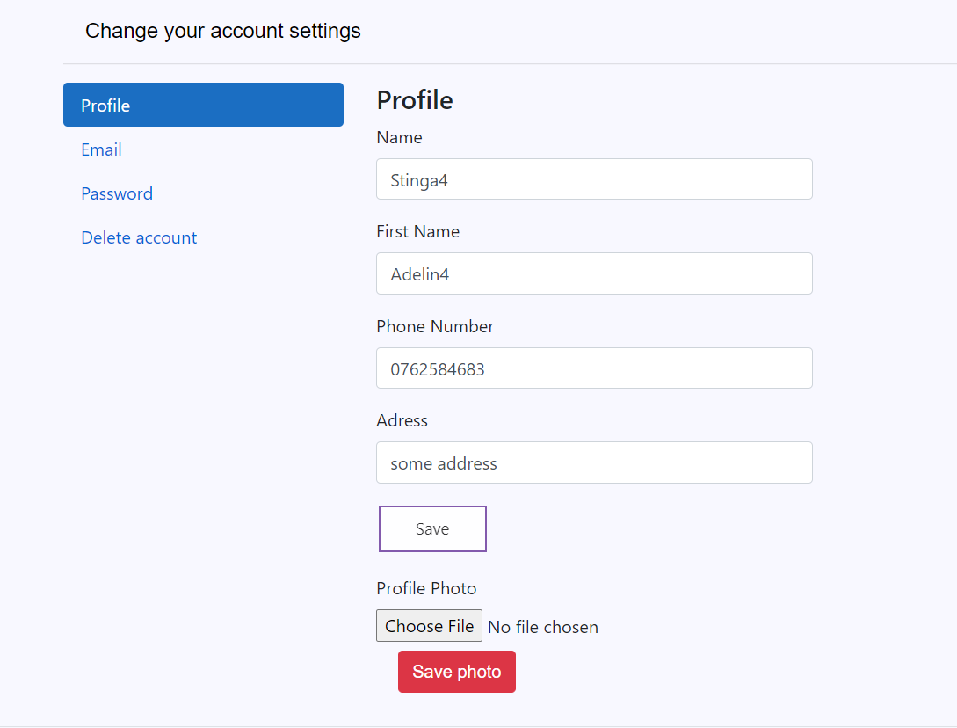
Profile
The profile tab offers the possibility for the user to change the name, surname, phone number or the address, as well as having the option to insert a profile picture

Slide 21
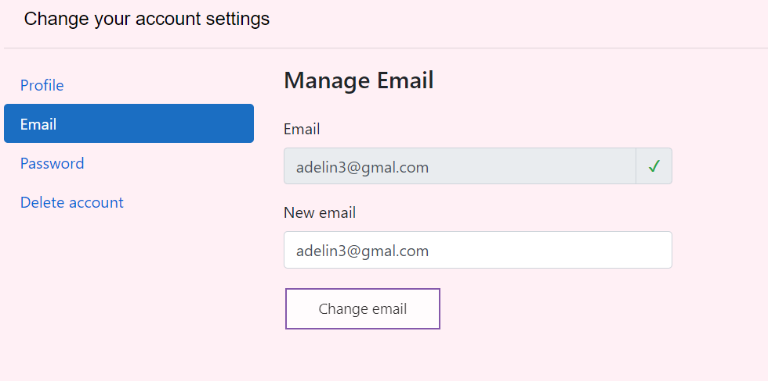
Email
The email tab offers the possibility to change the email information of the user

Slide 22
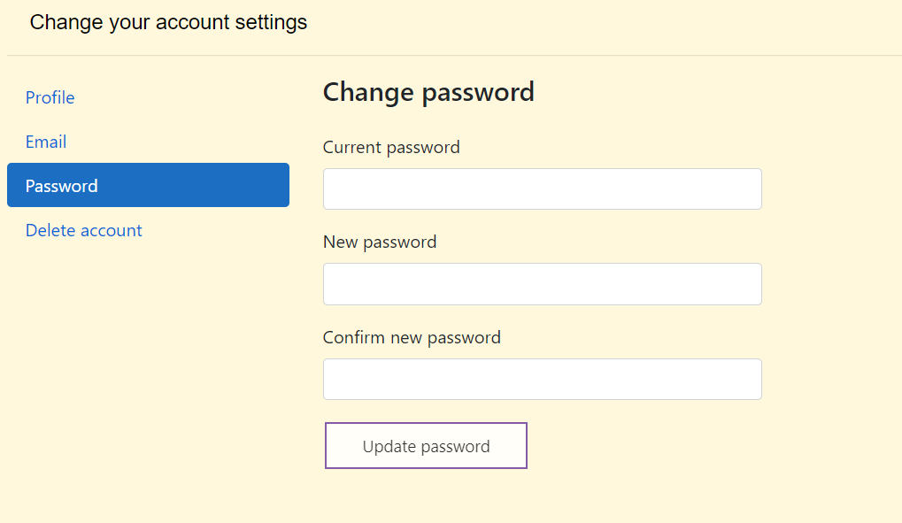
Password
The password tab let’s the user to change the password for the account

Slide 23
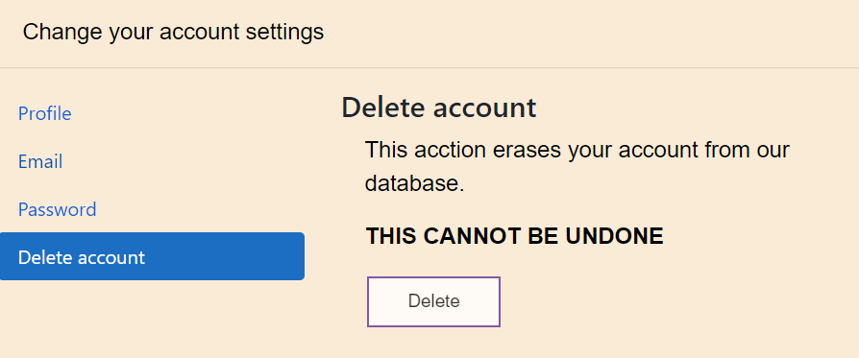
Delete account
The delete account tab allows the user to delete the whole account without the possibility to recover the flights booked

Slide 24
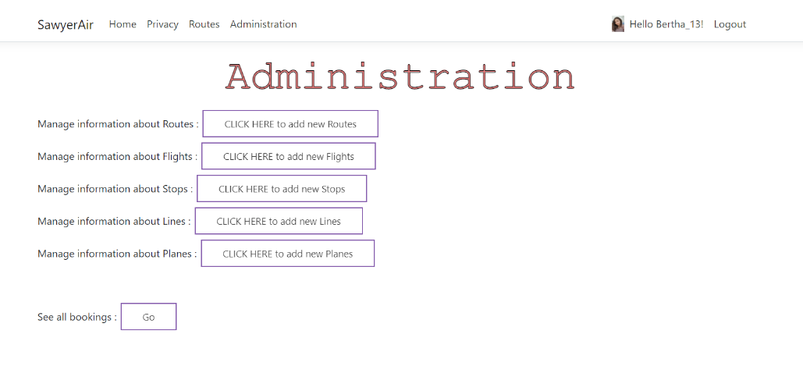
Administration
Some accounts are exclusive for the admins and they can manage the routes, flights, stops, lines and planes, they can add any new ones. The button is in the up left part of the app

